Slide 1

Building user interfaces Thomas Künneth

Slide 2
Like most UI frameworks, Compose knows two types of UI elements:
Interaction and display
Layout
UI is declared by nesting composables

Slide 3
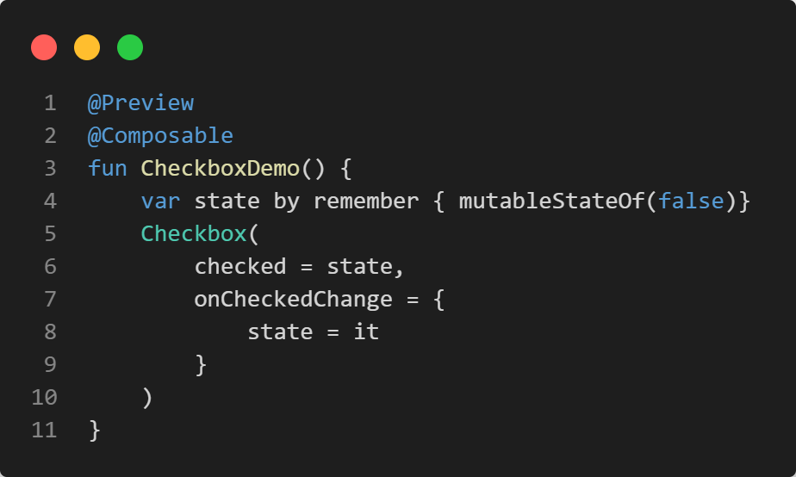
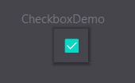
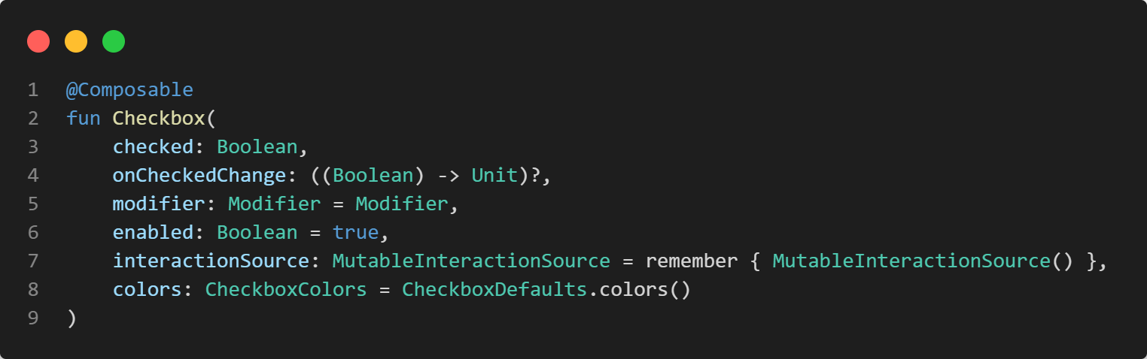

Slide 4
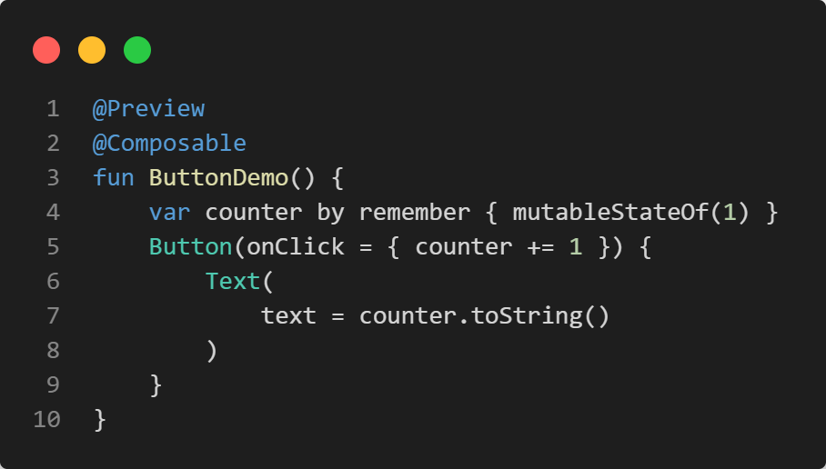
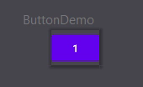
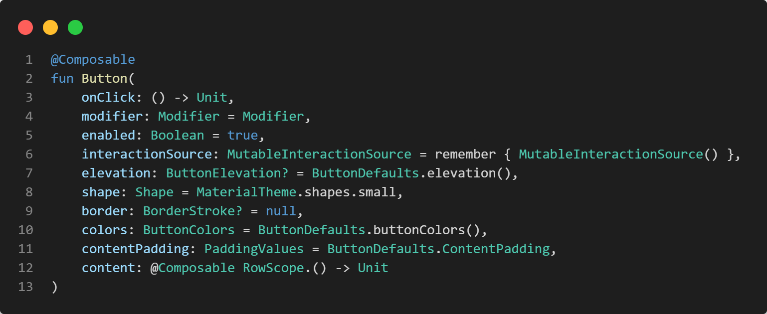

Slide 5
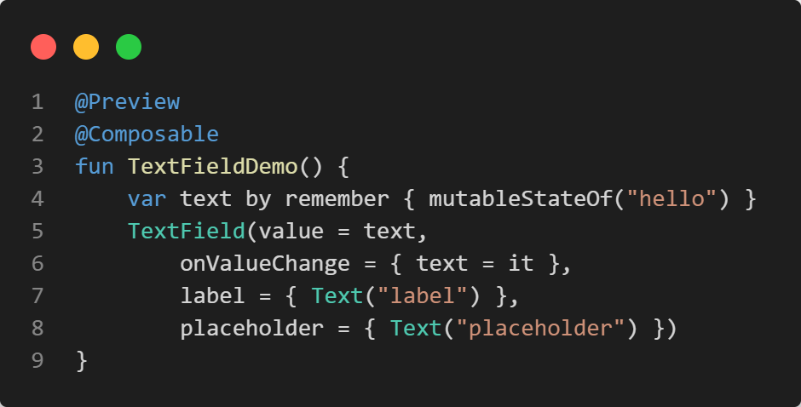
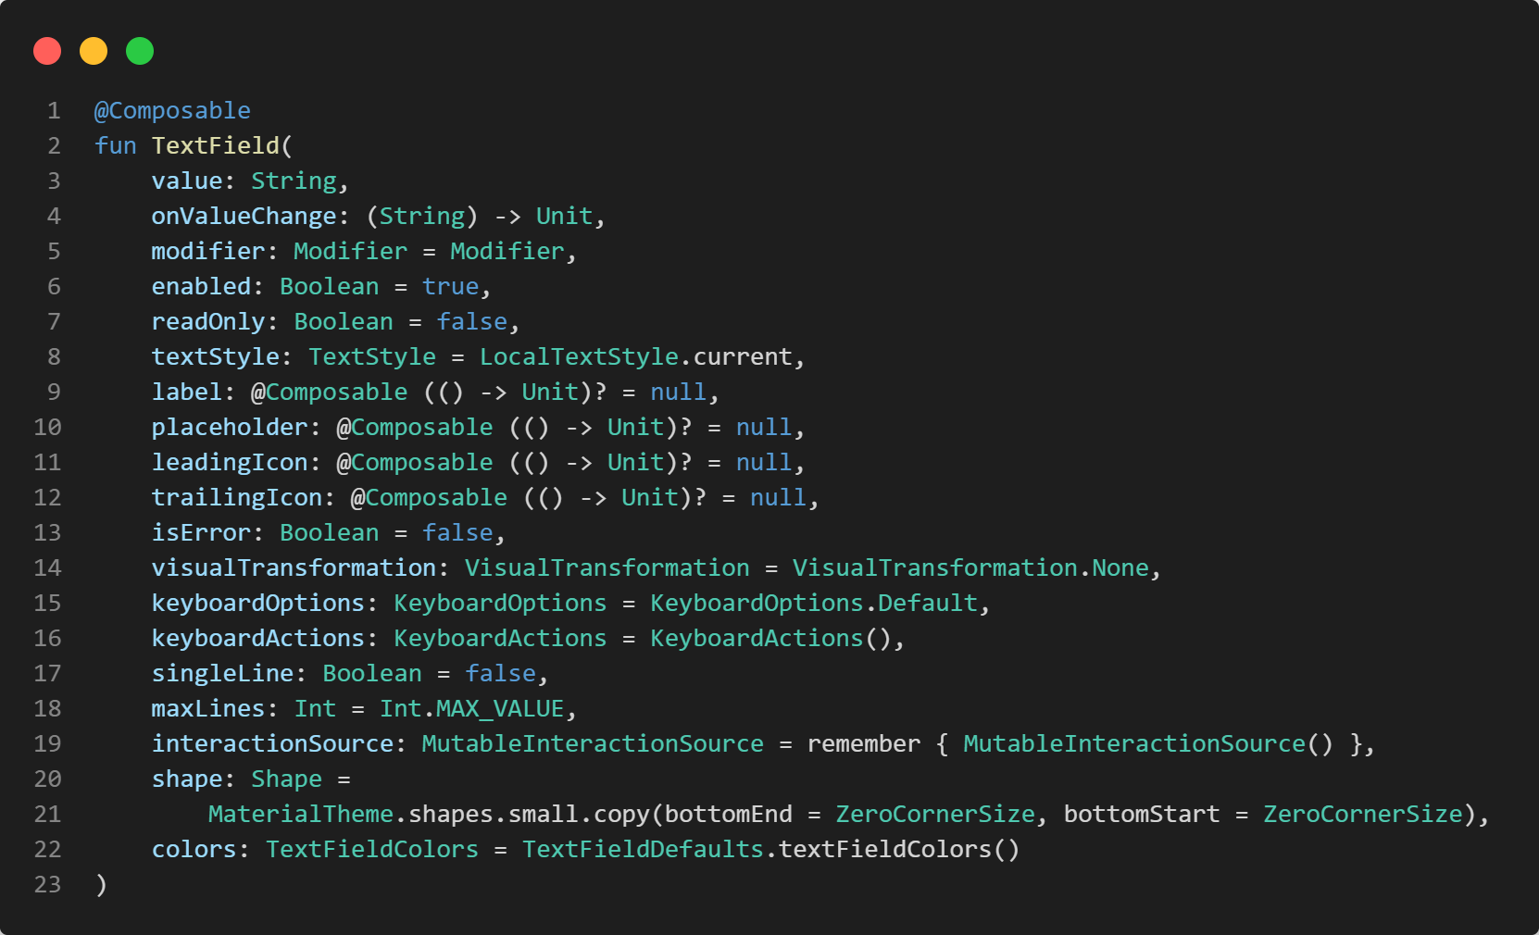
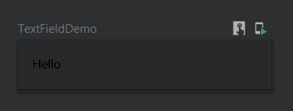

Slide 6
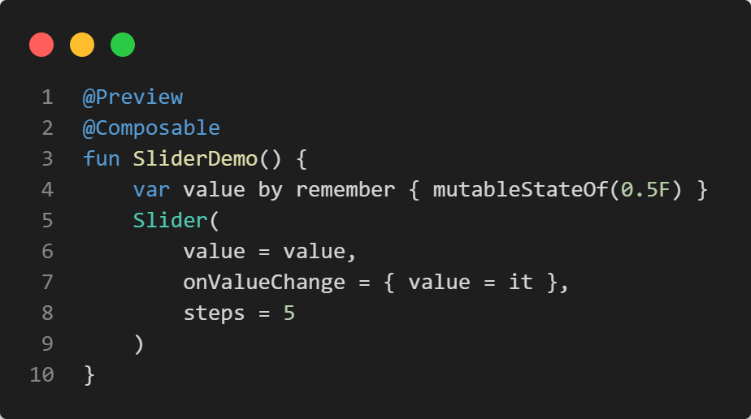
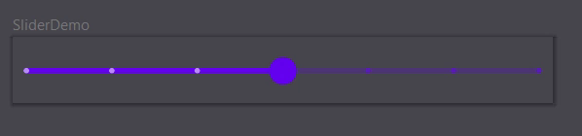
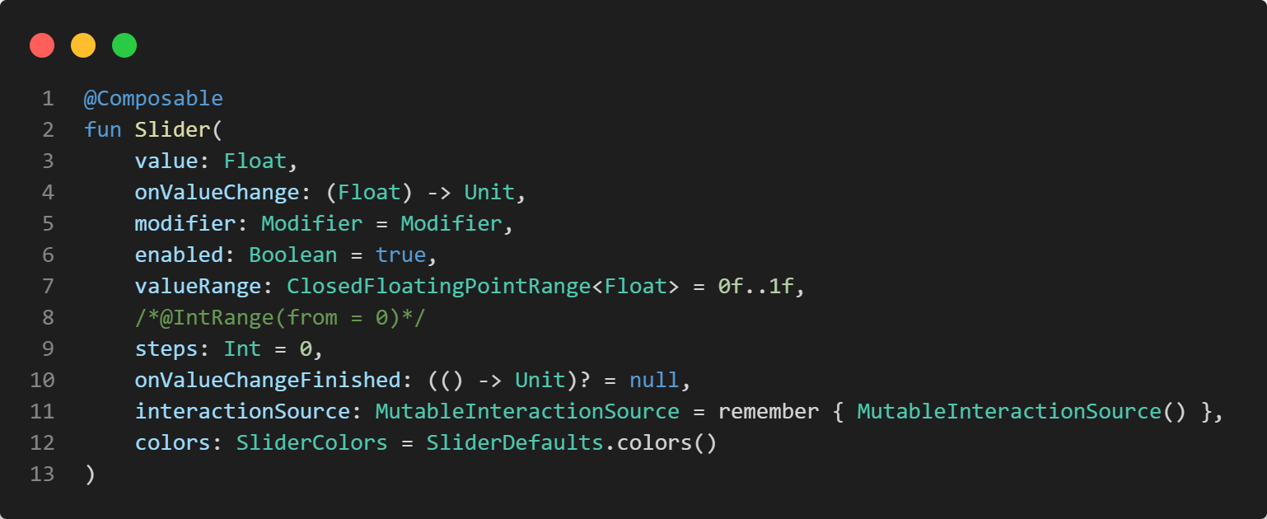

Slide 7
Row()
x axis
y axis
Column()
Box()
z axis

Slide 8
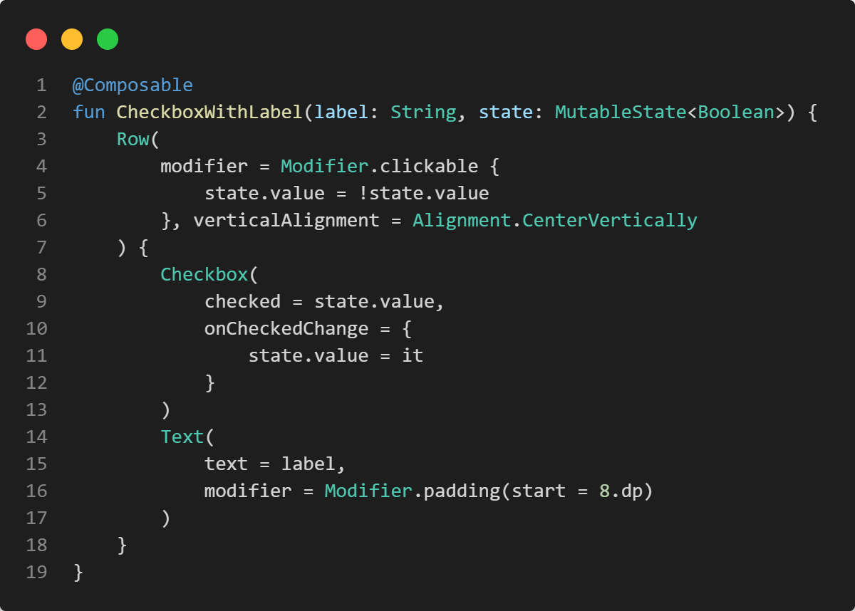
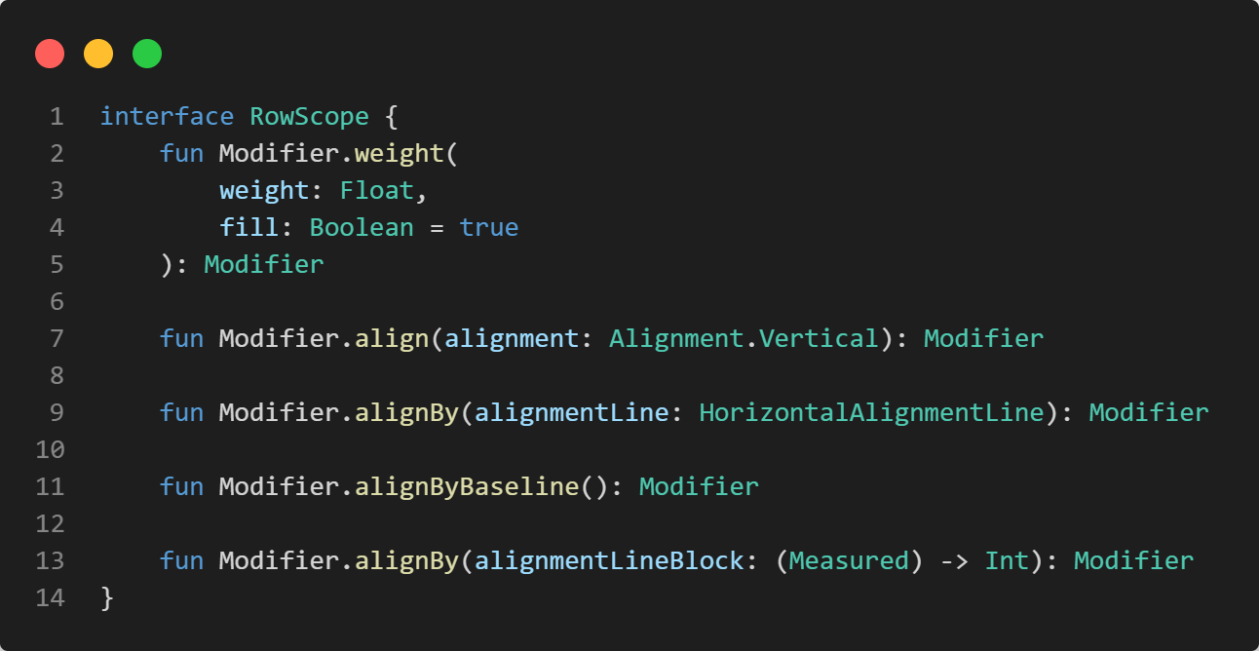
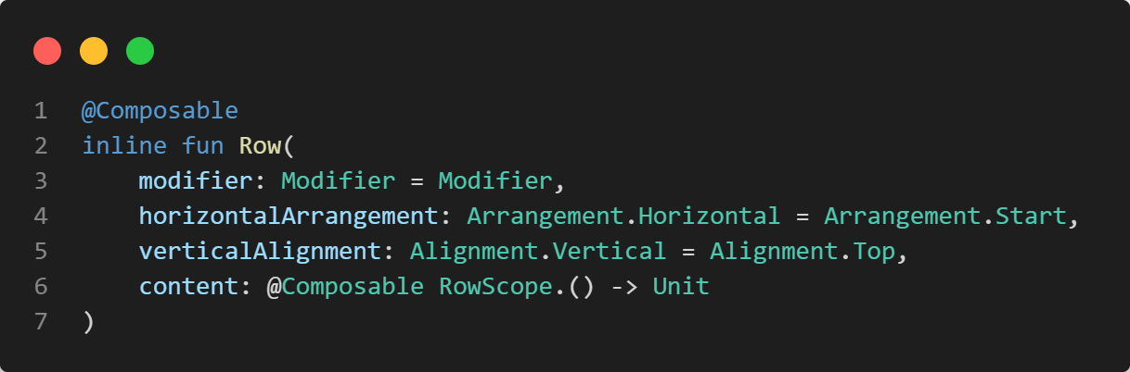

Slide 9
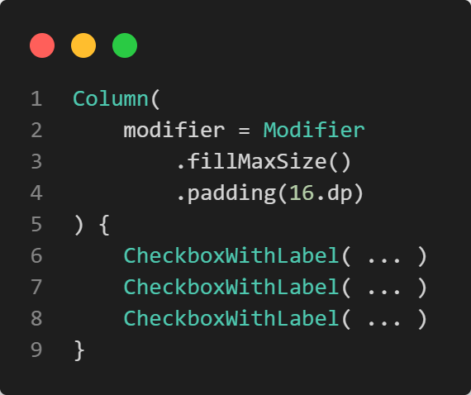
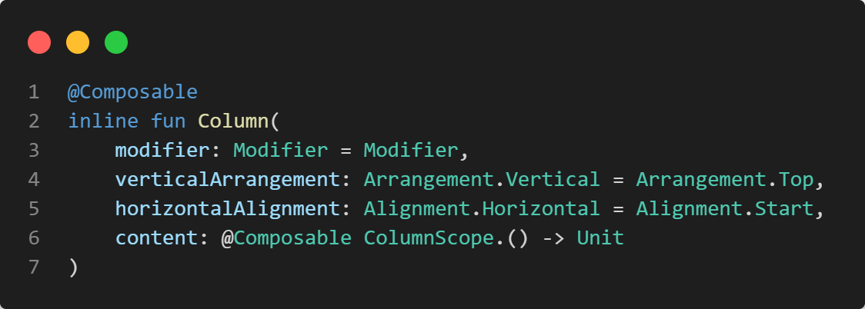
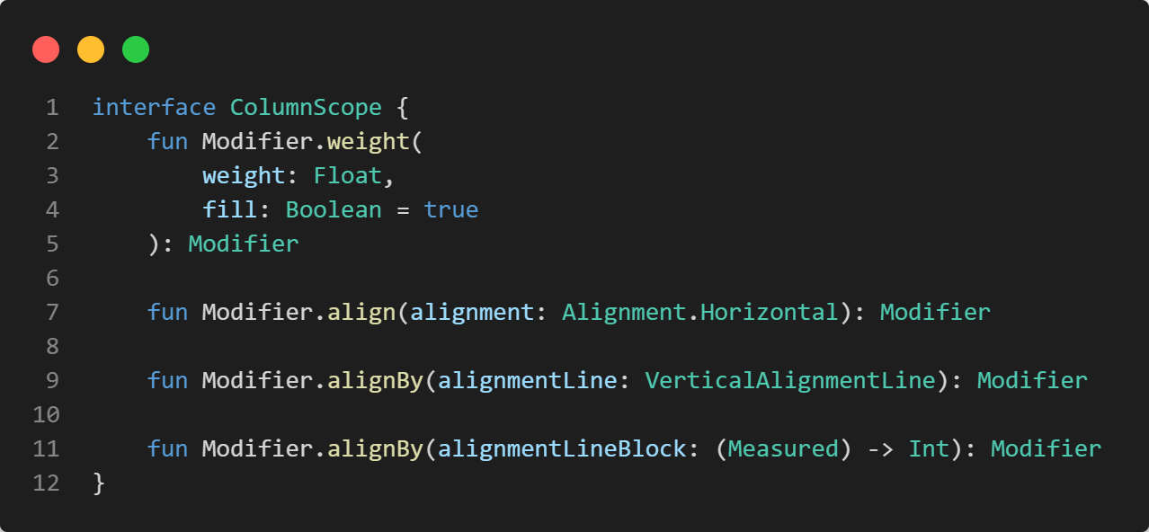

Slide 10
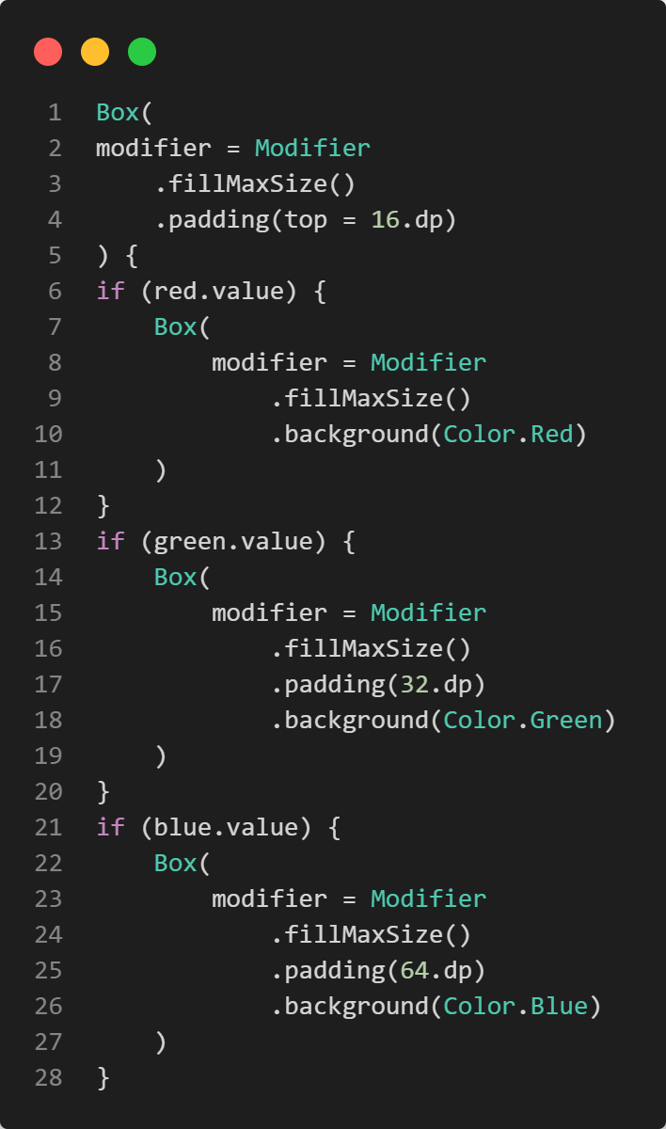
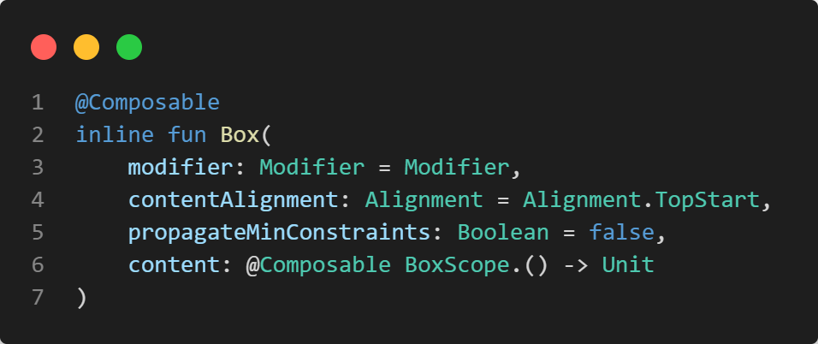
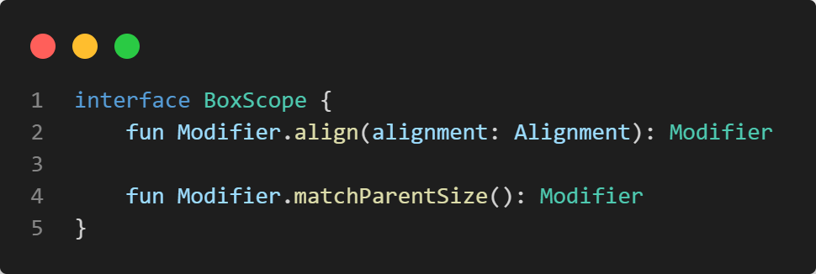

Slide 11
Isn‘t nesting layouts costly?🤔
Didn‘t Google introduce ConstraintLayout to better handle complex UIs?
With Jetpack Compose children are measured only once
So, layout hierarchies are no problem
But there’s ConstraintLayout(), too (after the break)

Slide 12
Non-visual composables
remember, mutableStateOf, ...
stringResource, dimensionResource, painterResource, ...
LaunchedEffect, DisposableEffect, ...

Slide 13

Exercise
https://unsplash.com/photos/IZOAOjvwhaM

Slide 14
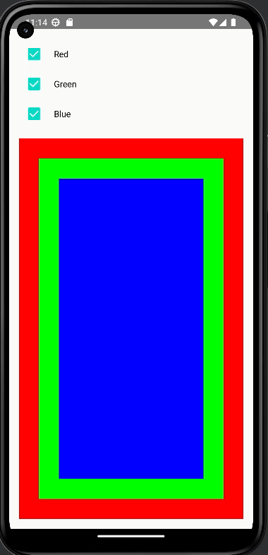
PredefinedLayoutDemo
Write an app with checkboxes that show and hide colored boxes
Use Row()to combine Checkbox() and Text()
Column() arranges the three labeled checkboxes and one Box() containing the colored boxes

Slide 15
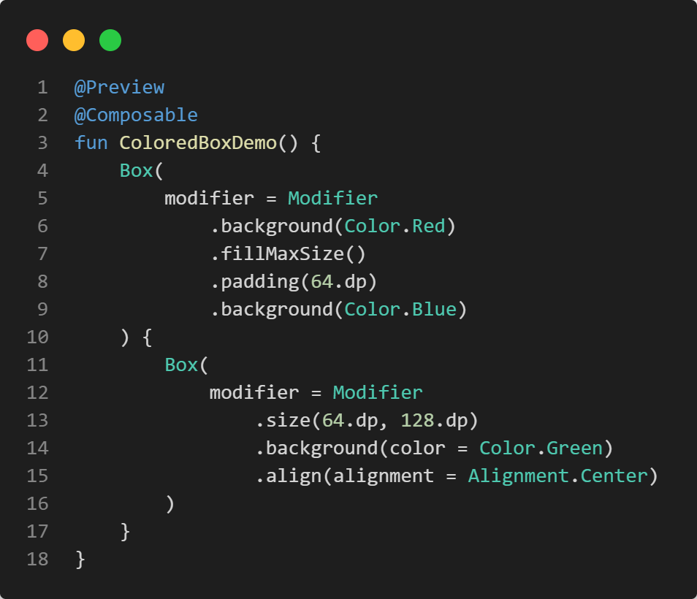
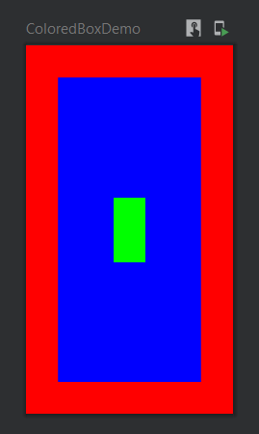

Slide 16
Modifier amend composables with visual properties and behavior
They form chains, which start with Modifier
The order in the code defines when a modifier is applied

Slide 17
.fillMaxSize() maximizes a composable
.width() and .size() declare the preferred width or size
.padding() creates an inward-facing space
.background(color = ...) creates a colored background

Slide 18

Further reading
Chapter 4: Laying Out UI Elements
free PDF

Slide 19

Questions…?
Lunch break… 😍

